Slide 1
Profit Prediction Using Supervised Classification Algorithms
SVM, KNN, Logarithmic Regression, DecisionTree

Slide 2
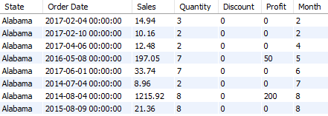
Data Set
Our Dataset is store-dataset which we stored in a MySQL Database.
This Dataset has 7 Attributes, ‘Order Date’, ‘Sales’, ’Quantity’, ‘Discounts’, ‘Profit’, ‘Month’.
The Store makes fixed Profit for a range of sales e.g. sales between $500 to $1000 have $75, and $1000 to $2000 have $200 of Profit.
Our objective is to predict the Monthly and Yearly sales of the store using Supervised Machine Learning

Slide 3




Tools
1
MySQL Server
2
Python3 Jupyter Notebook
3
Tableau Public 2020

Slide 4
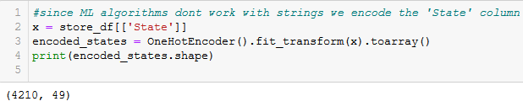
Data Preprocessing
In order to use the data for Machine Learning we need to convert it into machine understandable data.
For e.g. the States column is a type ‘String’ we use label encoding precisely One Hot Encoding t

Slide 5
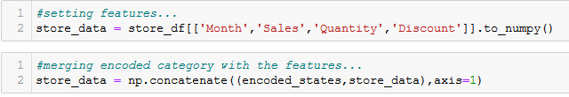
Data Preprocessing
Our Next step in data processing is converting the dataframe into Arrays.
We acheieve this using the ’to_numpy() ’ function of Pandas
Library.

Slide 6
Dataset Split Into Data Features and Label[Target Features]
Now we Divide the dataset into Training Features and Target Features.
Training Features or data features are features are used for as independent variables.
Label or Target Features are the dependent features we want to learn about and predict

Slide 7
Data Split into Training and Test Data
We split the data 70:30 into training and testing respectively,

Slide 8
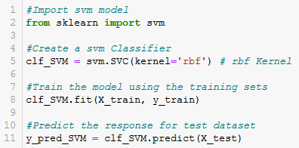
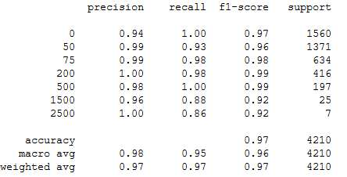
Training and Results - SVM

Slide 9

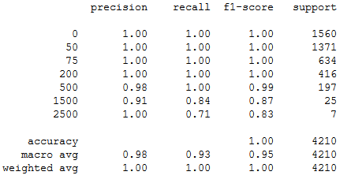
Training and Results - KNN

Slide 10
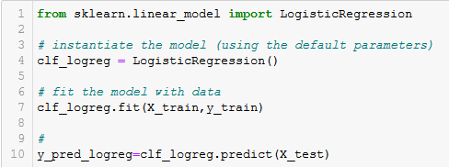
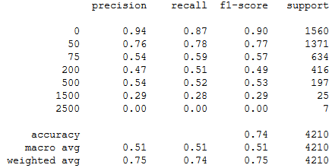
Training and Results – Logarithmic Regression

Slide 11
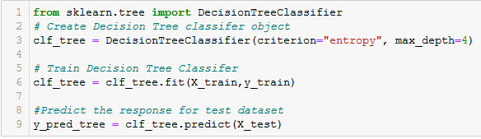
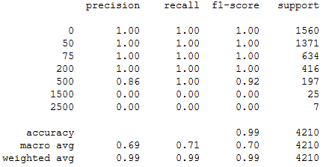
Training and Results – DecisionTree

Slide 12

Comparison.

Slide 13
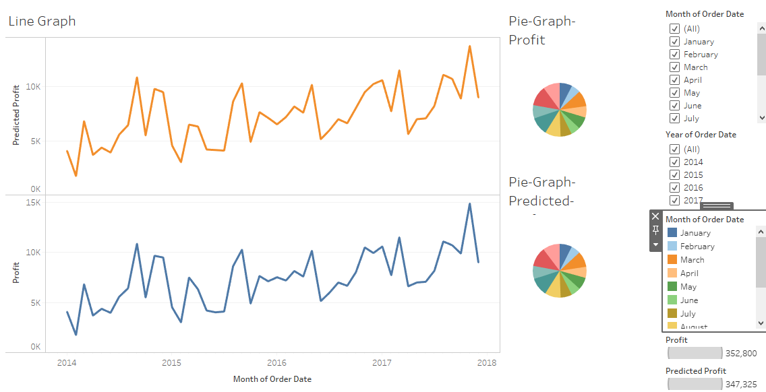
We visualize our results in Tableau
Notes:
In Slide Show mode, select the arrows to visit links.

Slide 14
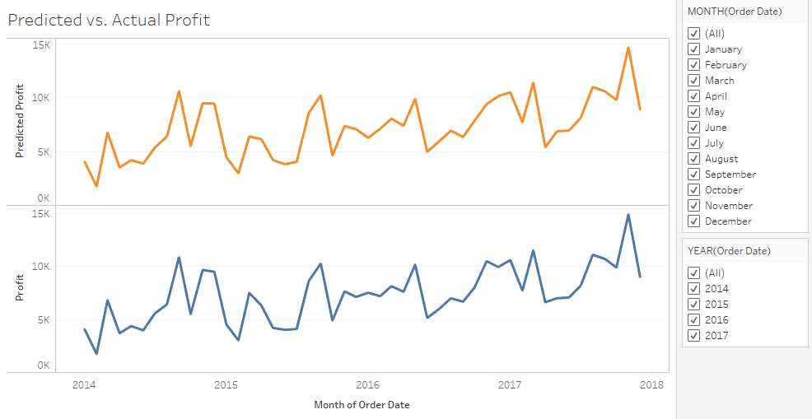
We compare results of SVM

Slide 15
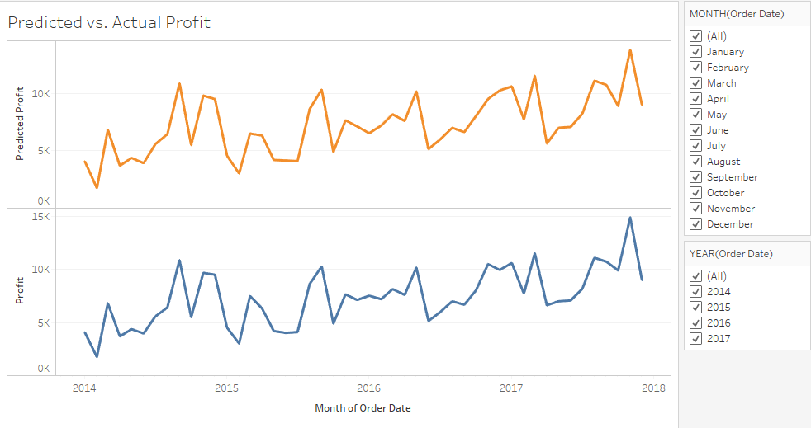
We compare results of KNN

Slide 16
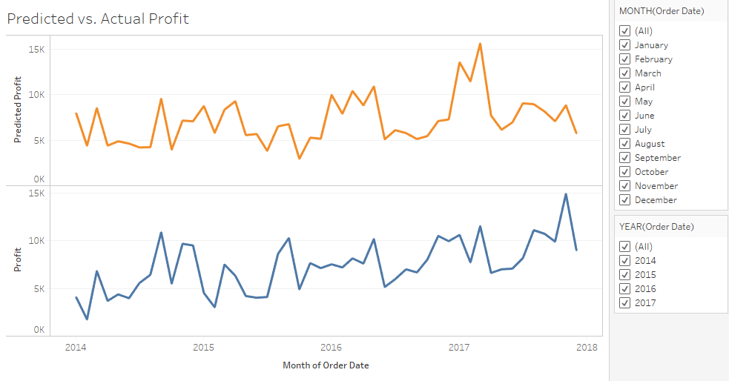
We compare results of Logarithmic Regression

Slide 17
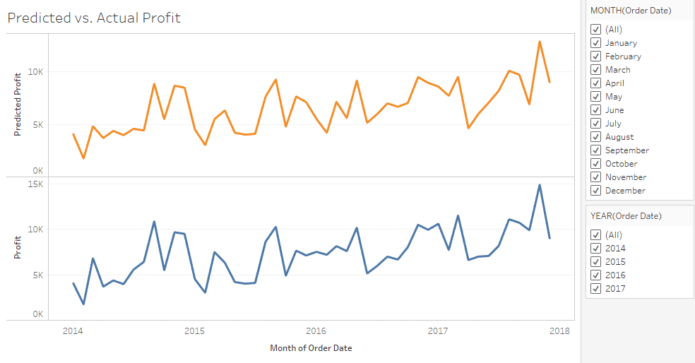
We compare results of Decision Tree

Slide 18
Complete Flow Chart
MySQL DB
(Store Data)
Python DataFrame
(pandas, pysql)
Machine learning
(Sklearn – KNN etc)
Tableau
Predicted Results as CSV

